Slide 1
2IMA20 Algorithms for Geographic Data
Spring 2016 Lecture 9: Cartograms

Slide 2
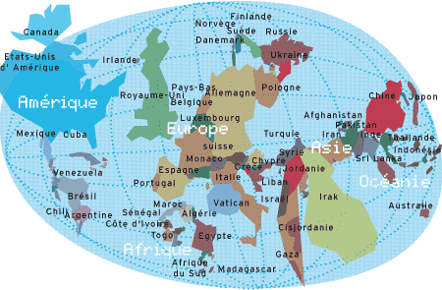
Cartograms
Cartographers use cartograms to visualize statistical data about sets of regions like countries.
Area of regions is not true area, but proportional to some geographic variable ➨ regions are deformed.

Slide 3
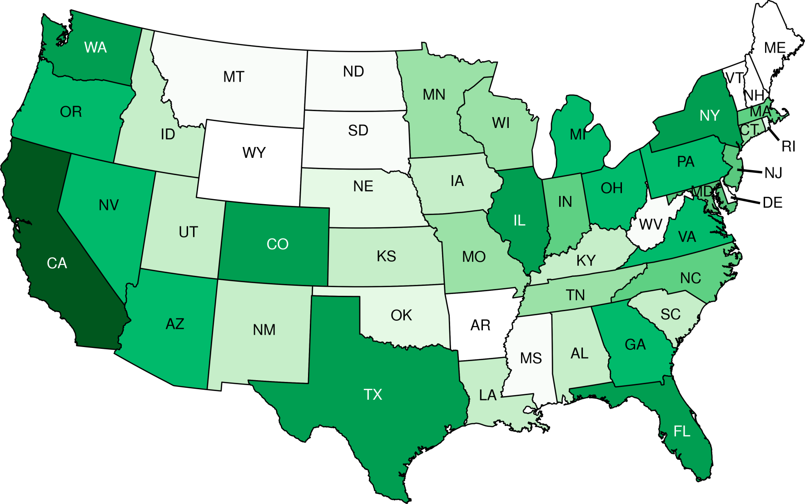
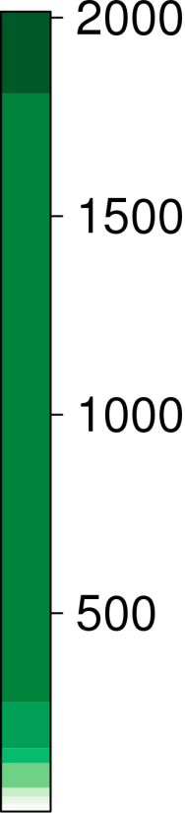

Cartograms
Choropleth map

Slide 4
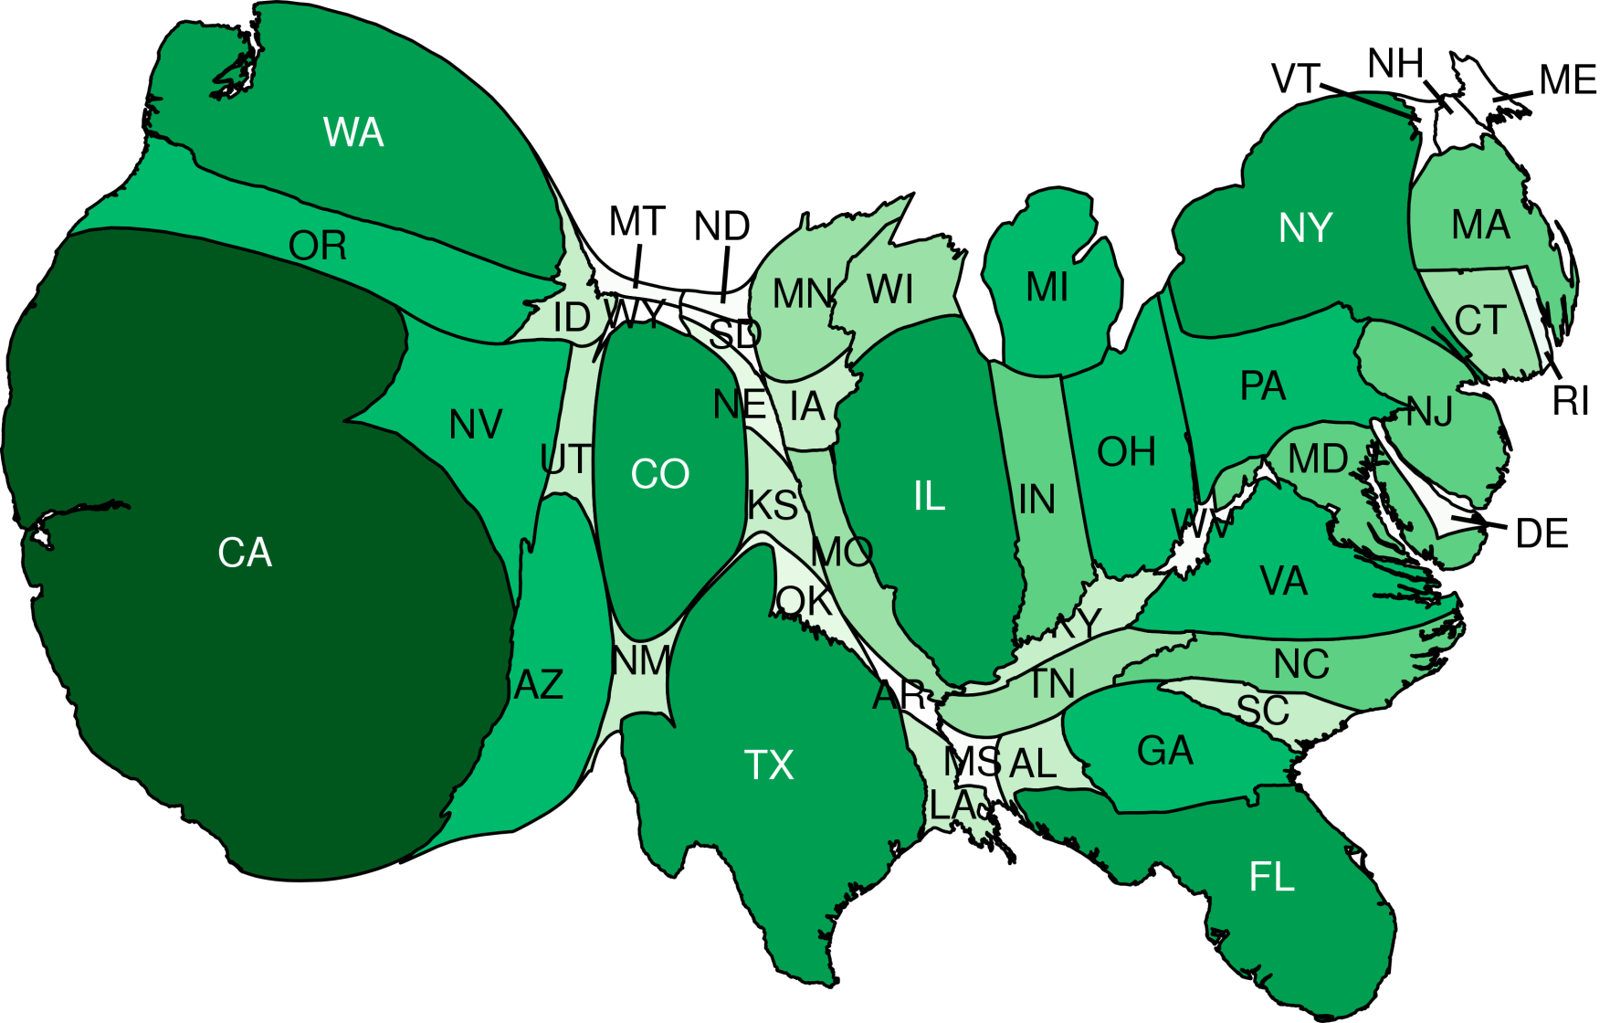

Cartograms

Slide 5
Types of cartograms
Contiguous area cartogram
Non-contiguous area cartogram
Dorling (circular) cartogram
Rectangular cartogram
Mosaic cartogram

Slide 6
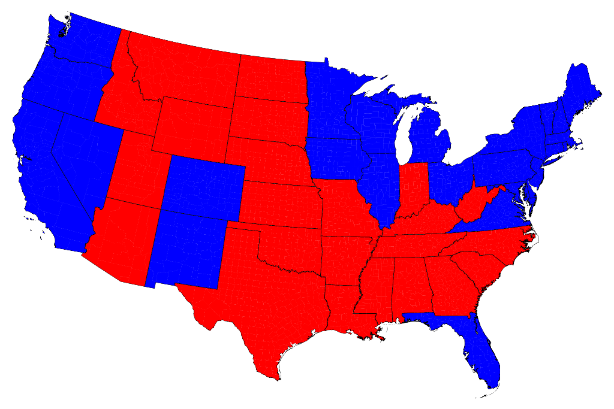
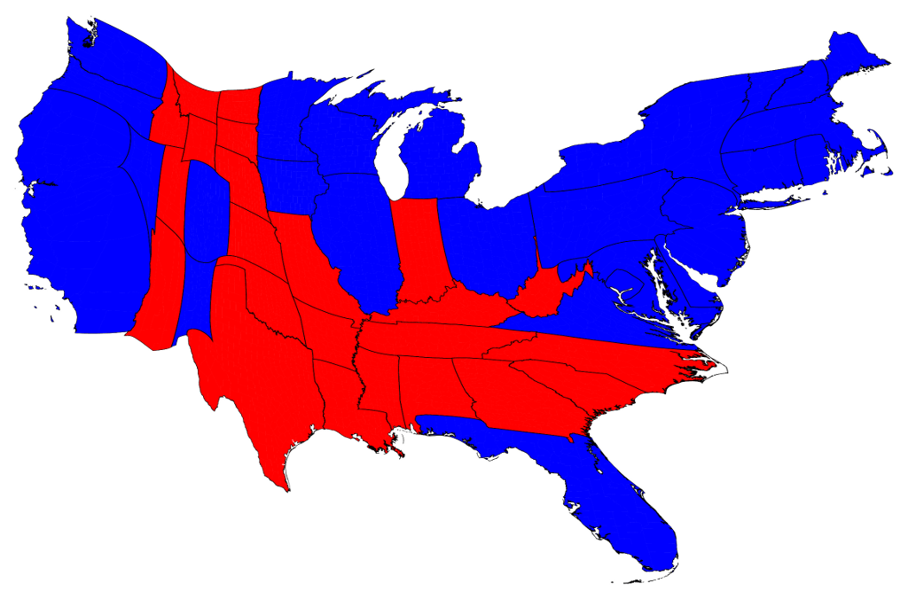
American election 2012

Slide 7
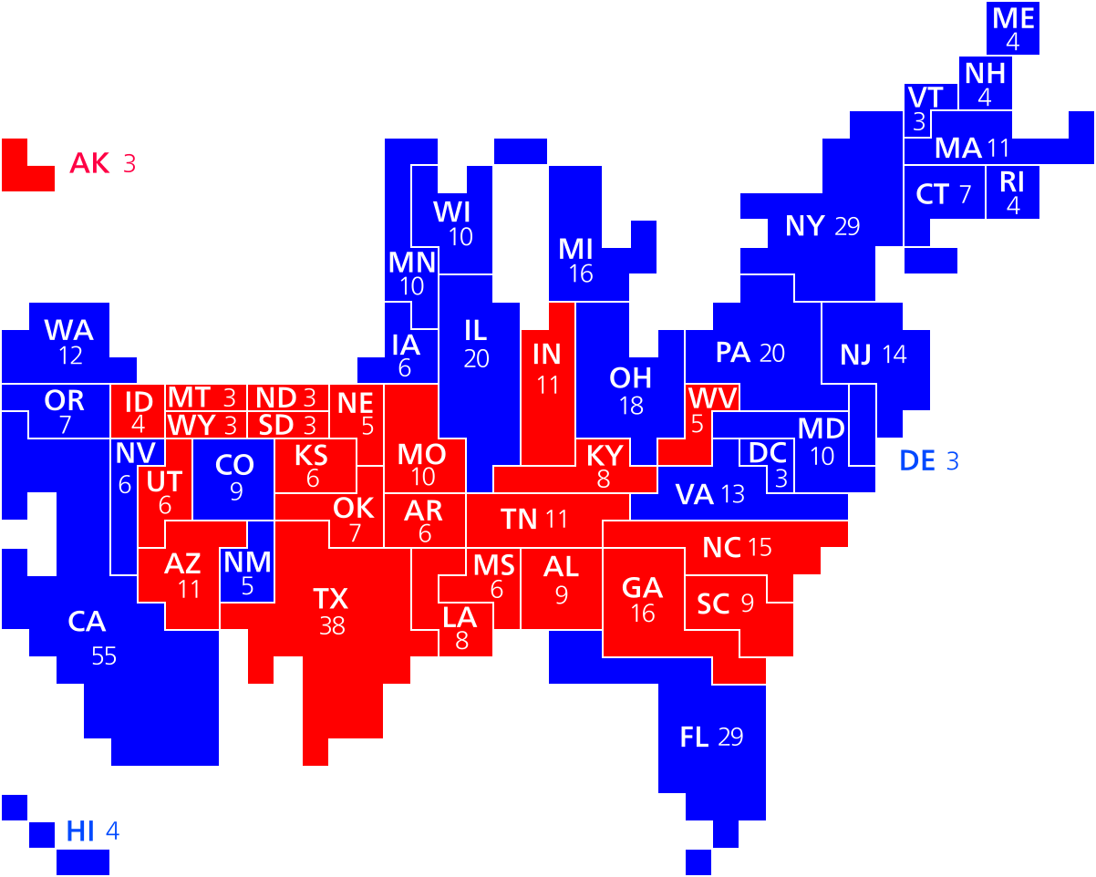
American election 2012

Slide 8
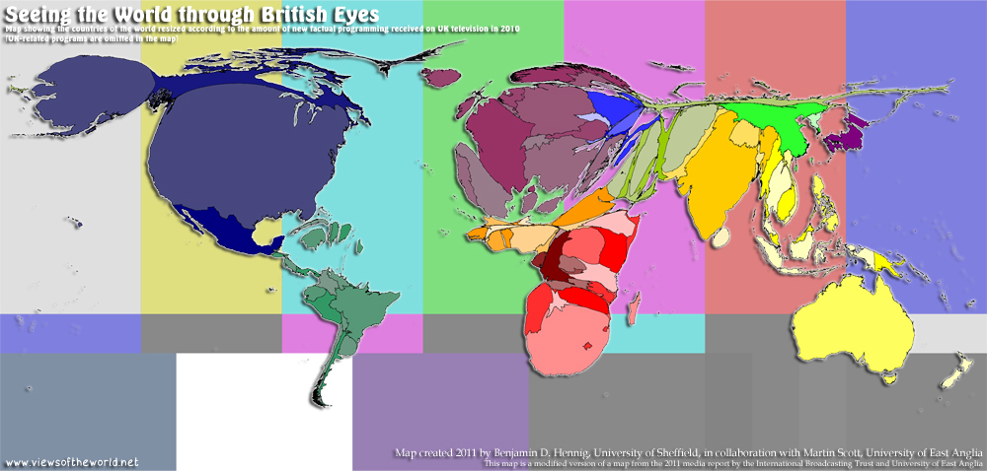
British TV in 2010

Slide 9
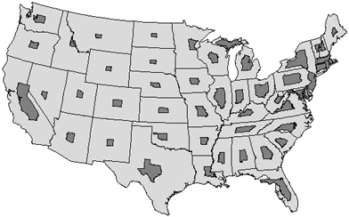
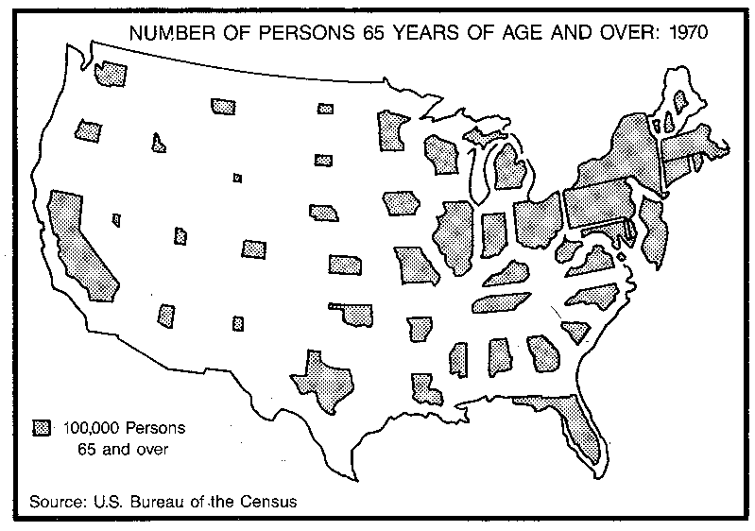
Non-contiguous area cartogram

Slide 10
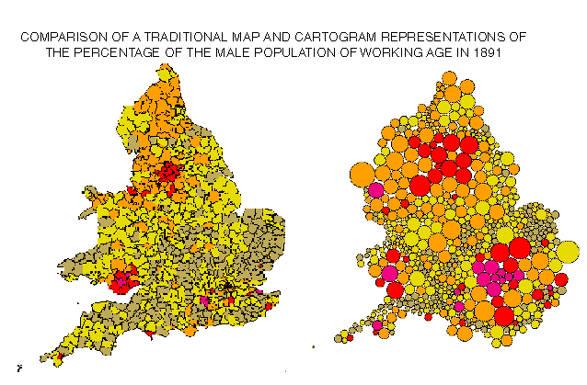
Dorling cartogram

Slide 11
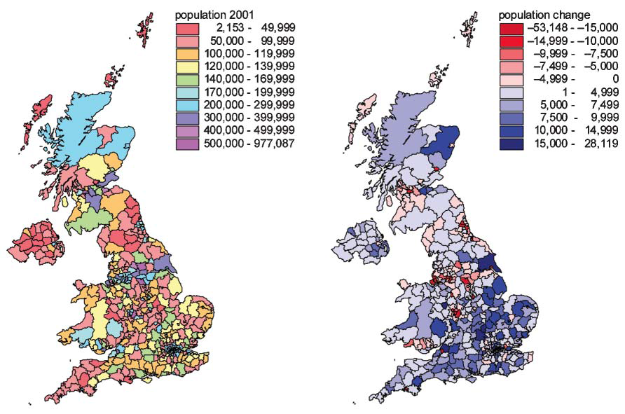
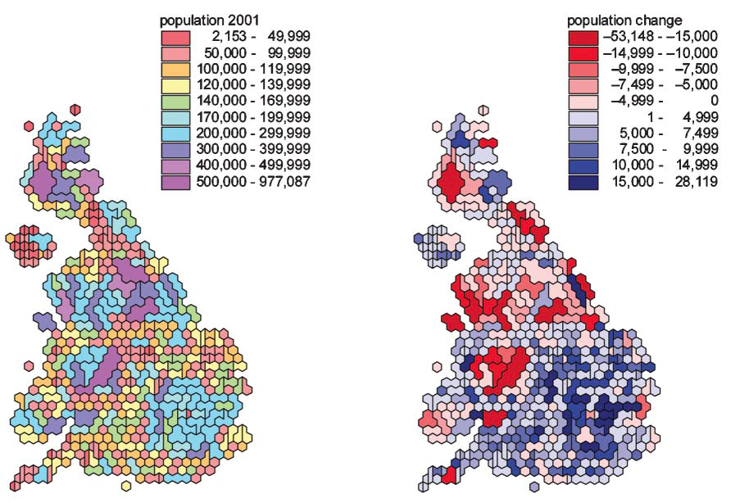
Mosaic cartograms (by Dorling)

Slide 12
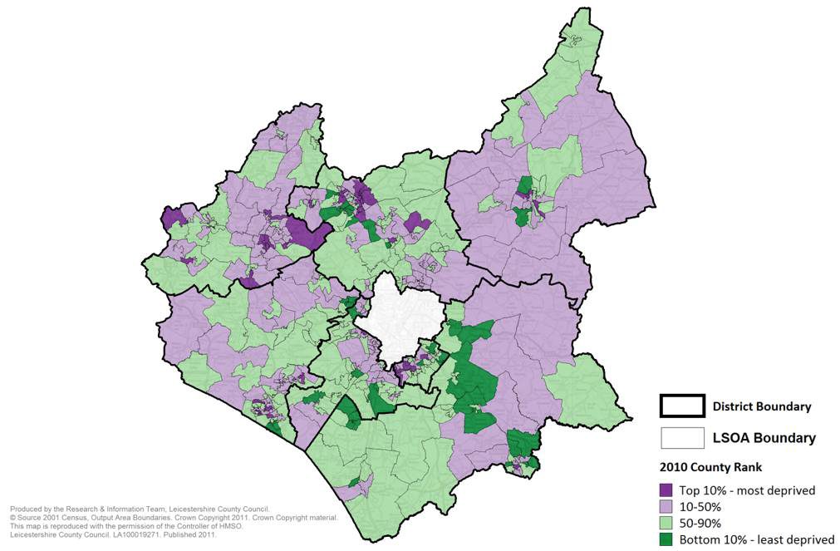
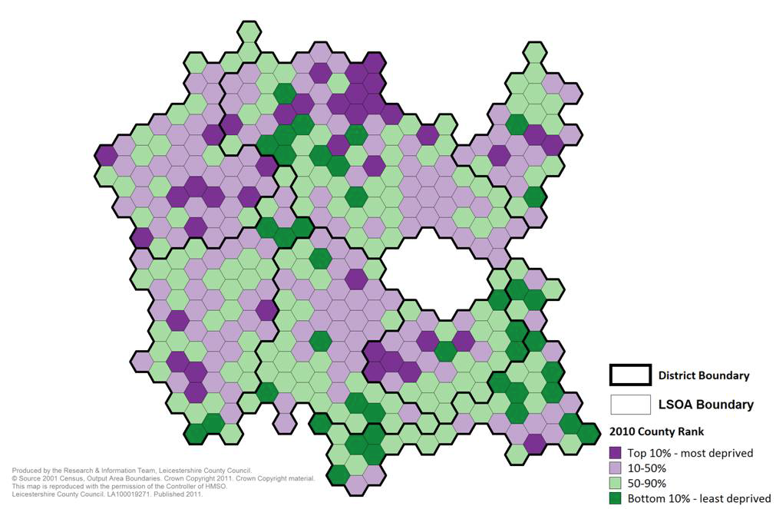
Mosaic cartograms

Slide 13
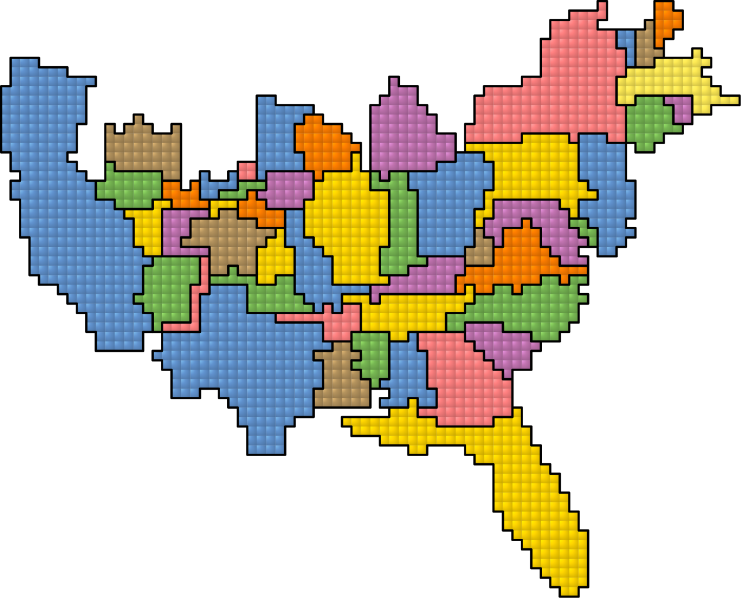
Mosaic cartograms

Slide 14
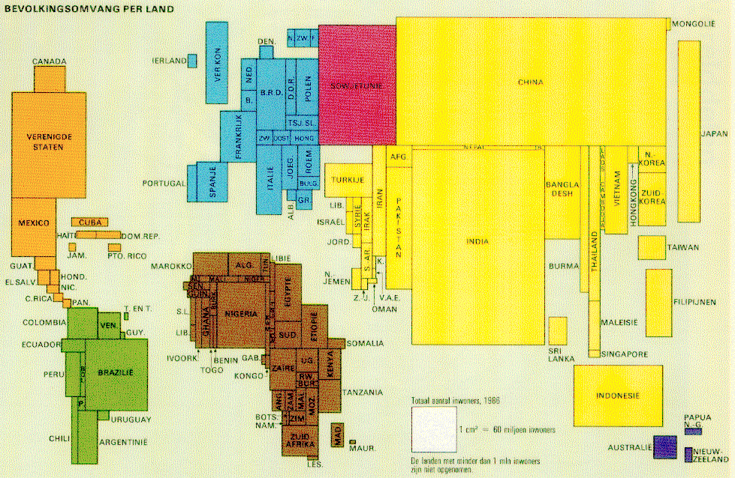
Rectangular cartograms

Slide 15
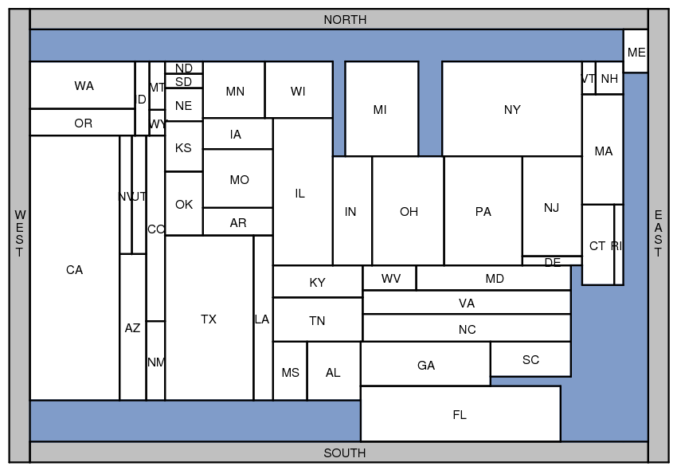
Rectangular cartograms

Slide 16
Rectangular cartograms
introduced by Raisz in 1934
Notes:
Population Limit 1, Aspect 12, zero error

Slide 17
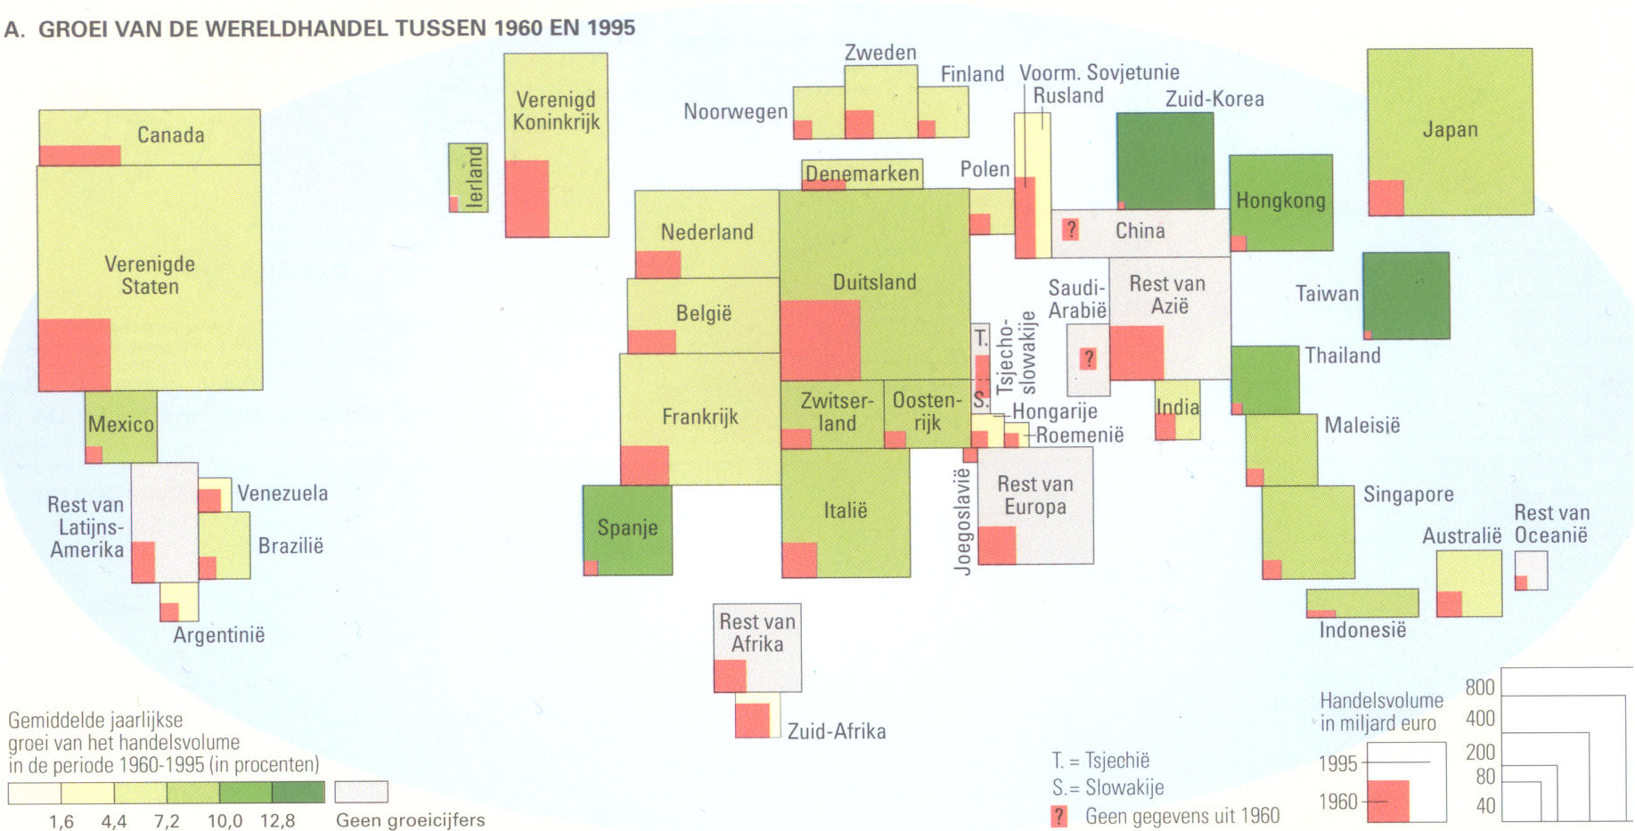
Rectangular cartograms

Slide 18
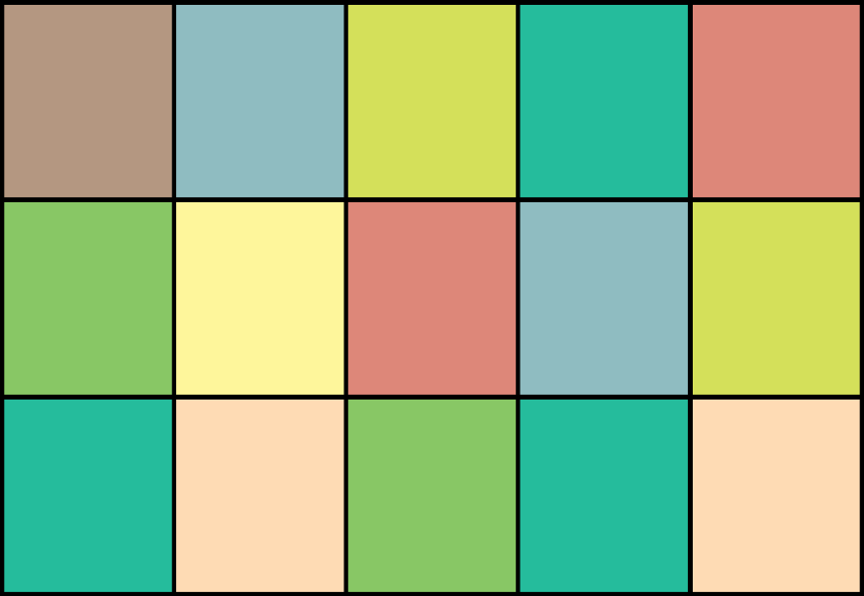
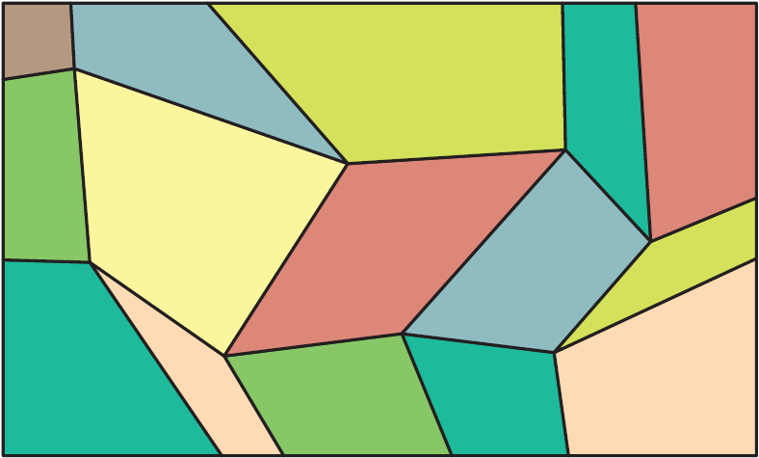
Table Cartograms
1
4
9
3
5
3
9
7
5
2
6
2
4
3
6

Slide 19
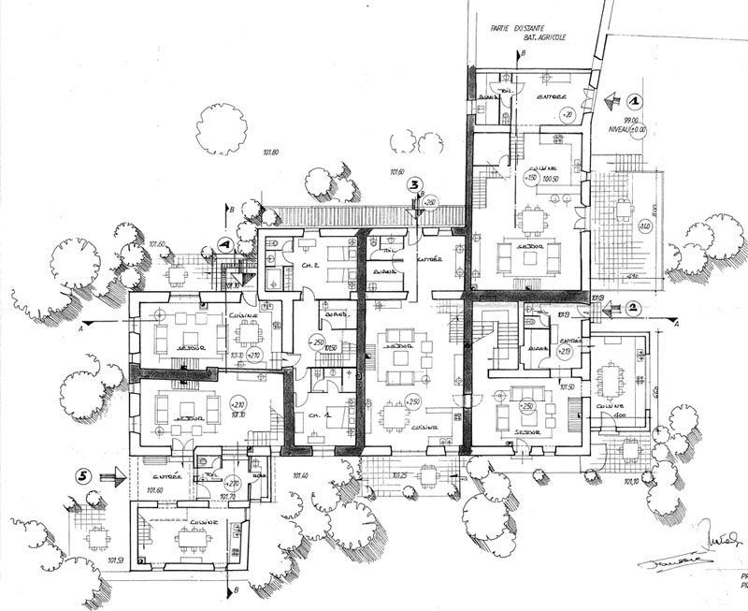
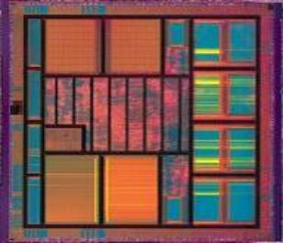
Other applications
Floorplans building architecture or VLSI layout

Slide 20
Rectangular Cartograms

Slide 21
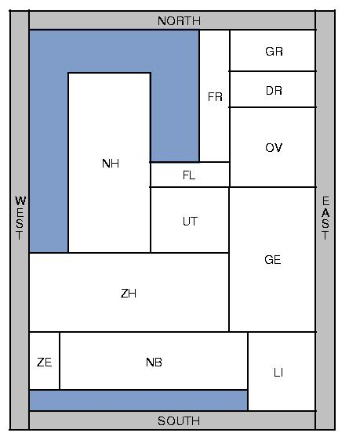
Rectangular cartograms
All regions are rectangles
Requirements:
Adjacencies correct
Areas correct
Approximate positions correct
Aspect ratio bounded

Slide 22
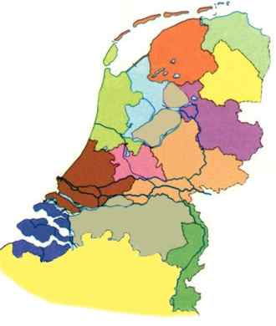
Correct adjacencies
Can we represent a planar graph by correctly adjacent rectangles?

Slide 23
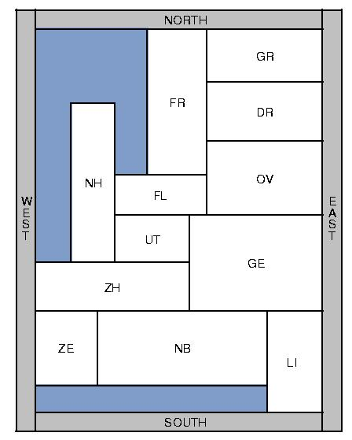
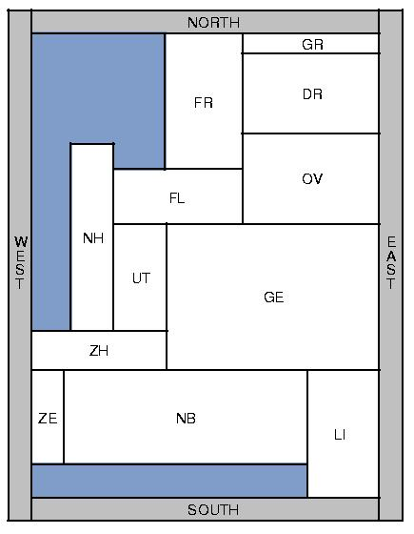
Correct areas
Can we give each rectangle the correct area as well?
area
nature area
population

Slide 24
Graph-theoretic formulation
12
14
We are given a plane triangulated graph G=(V,E) and a positive weight for each vertex.
We want to construct a partition of a rectangle into rectangular regions such that:
G is the dual graph of the partition (that is, the partition is a rectangular dual of G)
The area of each region is the weight of the corresponding vertex
14
10
4
16
11
20
7
21
14
14
12
14
10
4
16
5
20
11
7
21
14

Slide 25
Rectangular duals
[Kozminski & Kinnen ’85] A planar graph G has a rectangular dual with 4 rectangles on the boundary if and only if
every interior face is a triangle and the exterior face is a quadrangle
G has no separating triangles
Such a graph is also called an irreducible triangulation

Slide 26
Rectangular duals and layouts
The rectangular dual is not unique
[Kant & He, 1997] If relative positions are specified, then the rectangular dual is unique
➨ rectangular layout

Slide 27
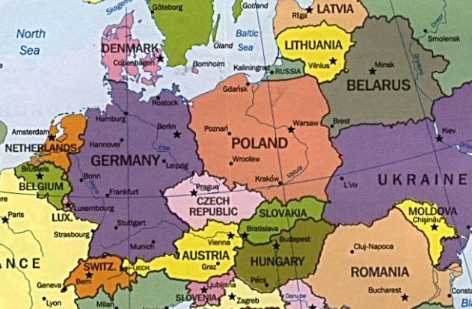
Problems on maps
Luxembourg
Paraguay
Malawi
Rwanda & Burundi
Moldova
Andorra
Nepal
Bhutan
Mongolia
Lesotho
Bundesland Berlin

Slide 28
Face graph
Face graph (triangulated)
Orientations on edges (WE, EW, NS, SN)
N
|
S
W-E

Slide 29
Realizable …
If the labels around every node read N+ W+ S+ E+ counterclockwise (corollary of [Kant & He ’97])
SN
SN
SN
EW
WE
EW
NS
NS

Slide 30
north
west
east
south

Slide 31
Rectangular layout
north
By the rectangular dual algorithm of Kant and He (1997)
O(n) time (for n rectangles)
west
north
east
west
east
south
south

Slide 32
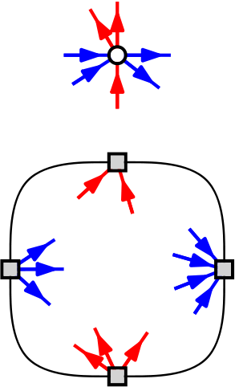
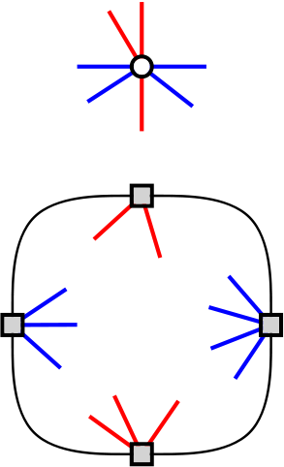
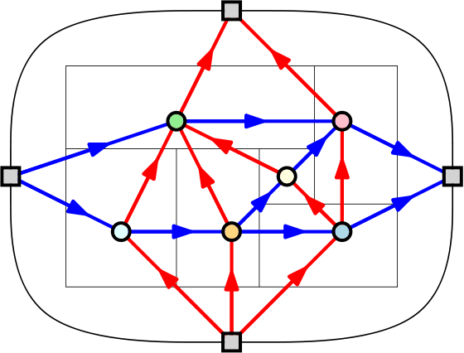
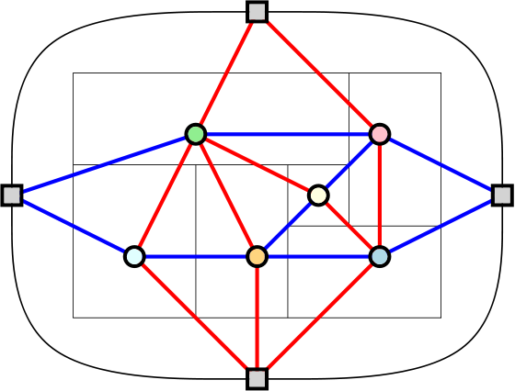
Regular Edge Labeling
A regular edge labeling (REL) of an irreducible triangulation:
Partition of interior edges into red and blue edges
We will omit the directions
Notes:
Vertex constraint
Exterior vertex constraint
Meaning of red and blue edges
Correspondence between Rect duals and RELs
<click> Directions are uniquely determined by the colouring and they aren’t very relevant for us
32

Slide 33
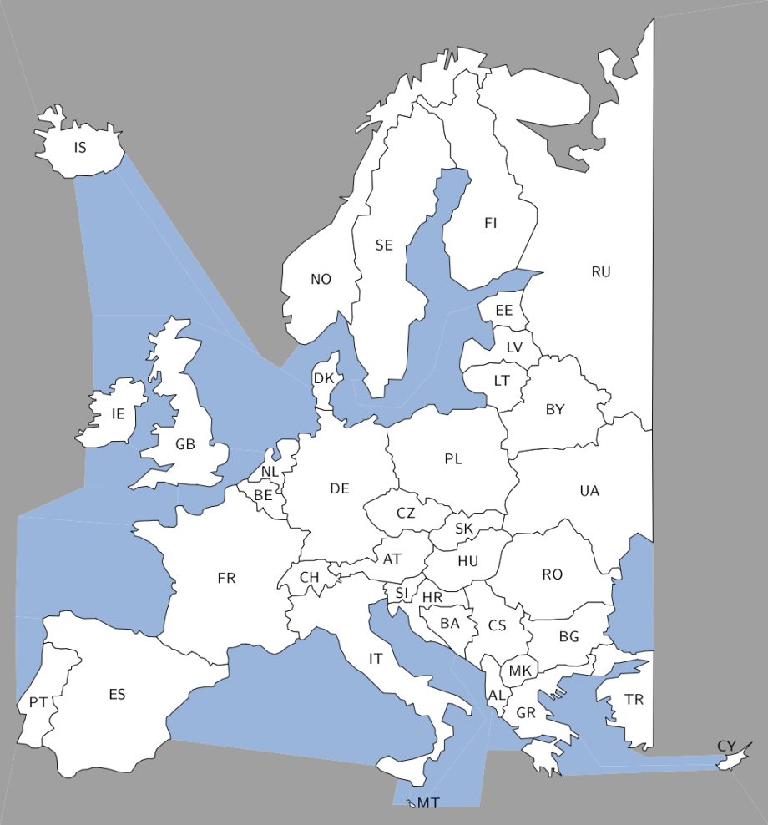
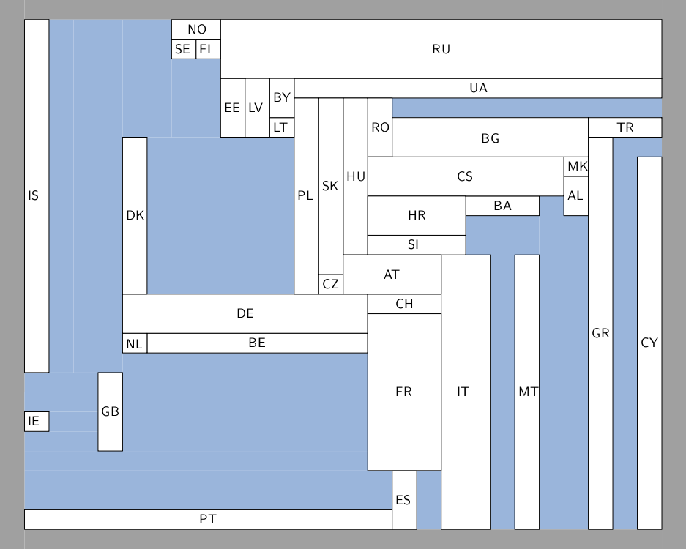
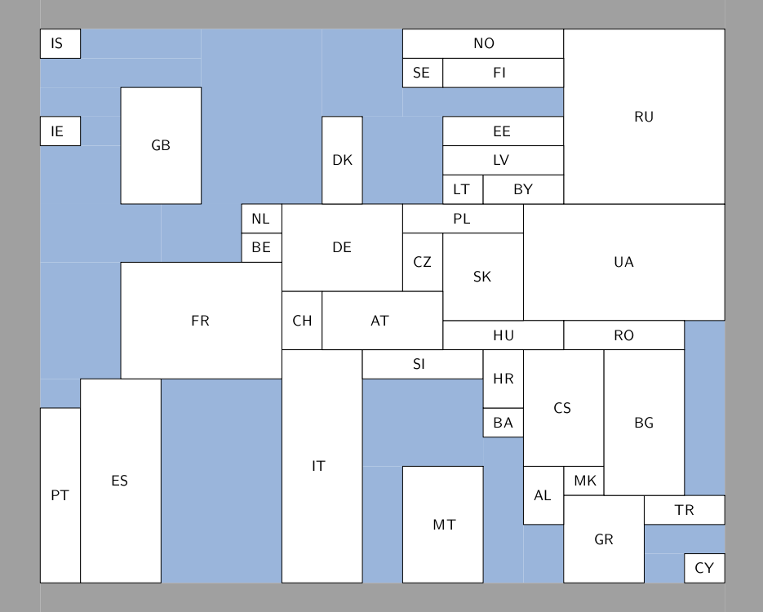
Rectangular Layouts

Slide 34
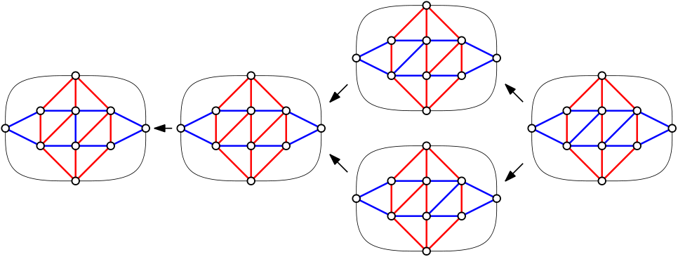
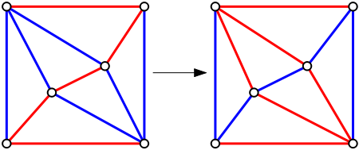
Distributive Lattice
The set of regular edge labelings of an irreducible triangulation form a distributive lattice [Fusy 2009]

Slide 35
Correct areas
It cannot always be done
But if a solution exists, then it is unique …
20
60
40
40
60
20
40
40
Desired areas
Best we can get ( 40+ε , 40-ε )

Slide 36
Possible solutions
try all layouts
exponentially many: lower bound 3.04263^{n} and upper bound 4.68^{n}
“good” layouts
different shapes
tolerate small errors in size
search in the lattice for good layouts
sliceable
one-sided
rectilinear

Slide 37
Possible solutions
try all layouts
exponentially many: lower bound 3.04263^{n} and upper bound 4.68^{n}
“good” layouts
different shapes
tolerate small errors in size
search in the lattice for good layouts
sliceable
one-sided
rectilinear

Slide 38
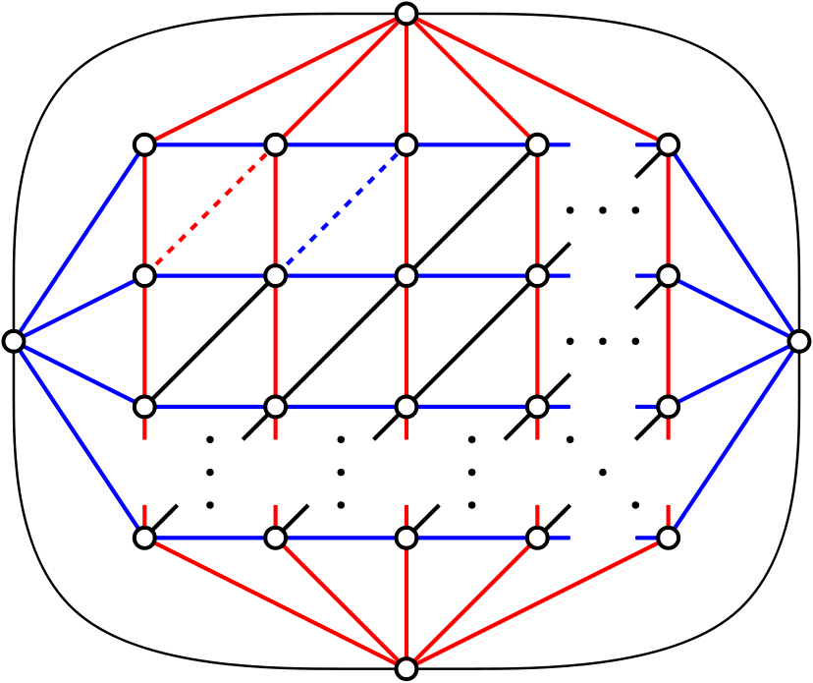
Lower Bound
Very restrictive: all grid edges are already coloured
Exponentially many:
Notes:
There are definitely graphs with an exponential number of labelings, as can be seen here. Each diagonal edge can be coloured independently in two different ways.
And this is still pretty restrictive, because there are also lots of labelings where some vertical edges are blue or some horizontal edges are red.
38

Slide 39
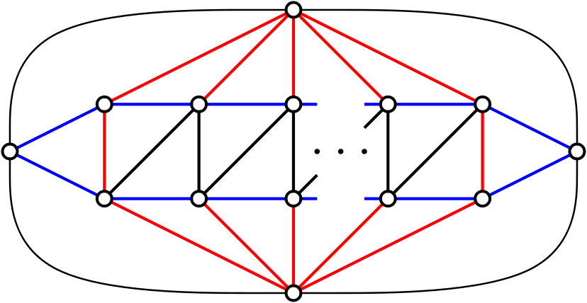
Lower Bound
A simple case:
Notes:
So let’s look at a simple case, a single row of grid cells.
39

Slide 40
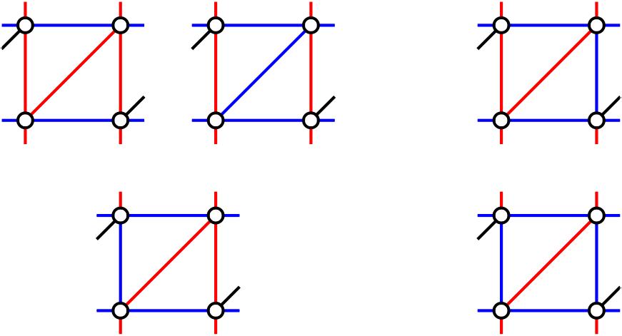
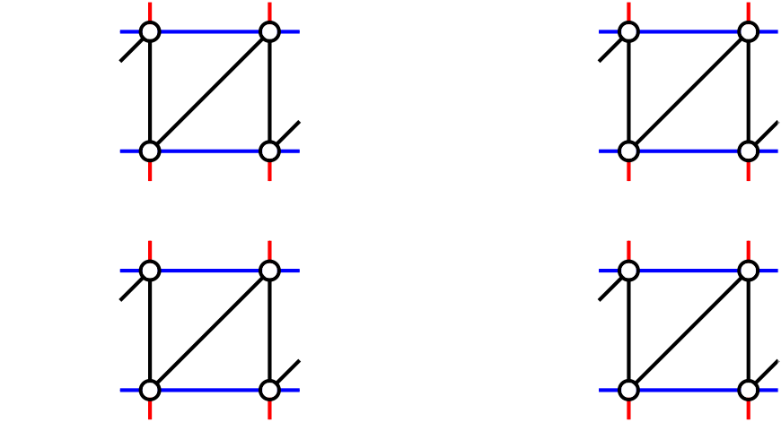
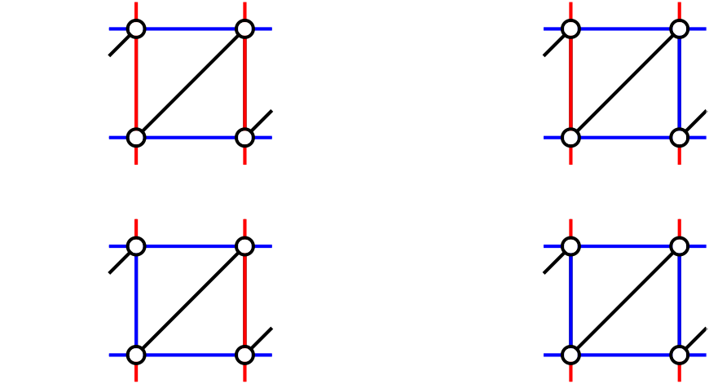
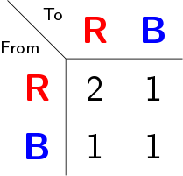
Lower Bound
Notes:
We can see this as a kind of transition system, where the vertical edges are the states and there are multiple ways of moving from each state to a new one.
We can represent this in a transition matrix.
40

Slide 41
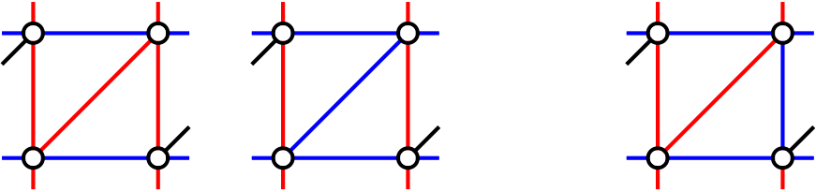
Lower Bound
Notes:
From this matrix, we can calculate the number of labelings that a row with a certain amount of columns has. With one column… with two columns…
Eventually, this converges to a factor times the previous number of labelings. This factor corresponds to the largest eigenvalue of the matrix.
41

Slide 42
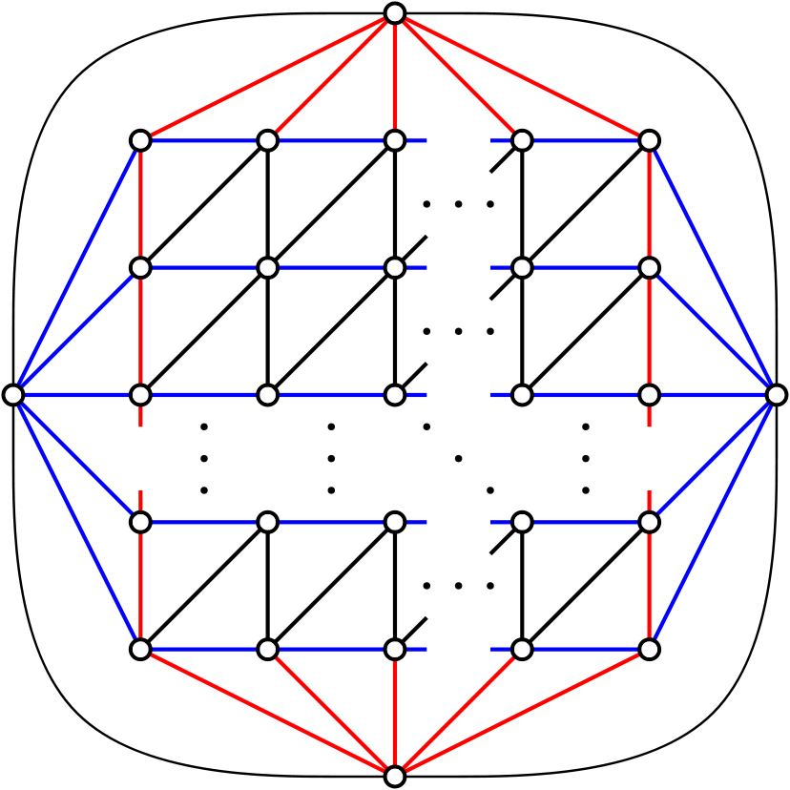
Lower Bound
All horizontal edges are blue ➨ still quite restrictive
If we glue k of these rows together:

Slide 43
Lower Bound
7 rows
7 rows
7 rows
By applying the technique to multiple rows, we get better bounds.
For 7 rows, the bound is

Slide 44
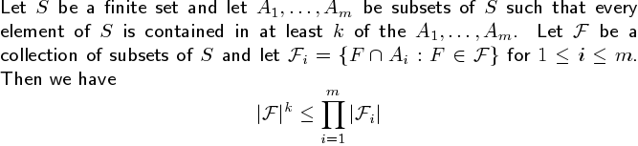
Upper Bound
Shearer’s entropy lemma
Notes:
It gives an upperbound on F, so if we take S as the set of all edges of the graph, we can let F be the collection of the set of blue edges for each labeling.
44

Slide 45
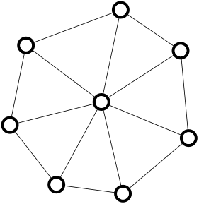
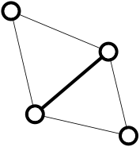
Upper Bound
Shearer’s entropy lemma
Notes:
45

Slide 46
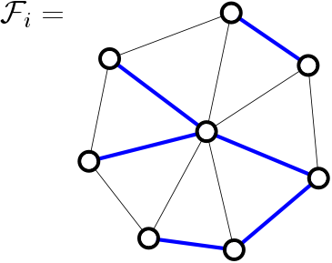
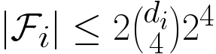
Upper Bound
Shearer’s entropy lemma
Notes:
46

Slide 47

Upper Bound
Shearer’s entropy lemma
Notes:
47

Slide 48
Possible solutions
try all layouts
exponentially many: lower bound 3.04263^{n} and upper bound 4.68^{n}
“good” layouts
different shapes
tolerate small errors in size
search in the lattice for good layouts
sliceable
one-sided
rectilinear

Slide 49
Possible solutions
try all layouts
exponentially many: lower bound 3.04263^{n} and upper bound 4.68^{n}
“good” layouts
different shapes
tolerate small errors in size
search in the lattice for good layouts
sliceable
one-sided
rectilinear

Slide 50
Area-universal layouts
Area-universal layout L for every assignment of weights to the areas of L there is a layout L’ equivalent to L such that the areas of L’ have the correct weights.
Uses animations; morphs; layout first – function later

Slide 51
Area-universal layouts
Area-universal layout L for every assignment of weights to the areas of L there is a layout L’ equivalent to L such that the areas of L’ have the correct weights.
Theorem A layout is area-universal, if an only if it is one-sided.

Slide 52
One-sided layouts
One-sided layout L every maximal line segment of L must be the side of a least one rectangle
maximal vertical segment
maximal horizontal segment

Slide 53
One-sided layouts
One-sided layout L every maximal line segment of L must be the side of a least one rectangle

Slide 54
One-sided layouts
One-sided layout L every maximal line segment of L must be the side of a least one rectangle
Theorem A layout is area-universal, if an only if it is one-sided.
Area-universal layout L for every assignment of weights to the areas of L there is a layout L’ equivalent to L such that the areas of L’ have the correct weights.

Slide 55
Equivalent layouts
These layouts are not equivalent!

Slide 56
Equivalent layouts

Slide 57
Equivalent layouts

Slide 58
Equivalent layouts

Slide 59
Equivalent layouts

Slide 60
Equivalent layouts

Slide 61
Equivalent layouts
These two layouts are not equivalent …

Slide 62
Order-equivalent layouts
These two layouts are not equivalent … but they are order-equivalent.

Slide 63
Order-equivalent layouts
Order-equivalent layouts two layouts are order-equivalent if their rectangles and maximal segments correspond one-for-one such that the partial orders match.
Define a partial order on the vertical maximal segments
Define a symmetric order on the horizontal maximal segments

Slide 64
There can be only one …
[Wimer, Koren, and Cederbaum ‘88] For any layout L and any assignment of weights to the areas of L there is at most one layout L’ order-equivalent to L such that the areas of L’ have the correct weights.

Slide 65
… and there always is one.
[Wimer, Koren, and Cederbaum ‘88] For any layout L and any assignment of weights to the areas of L there is at most one layout L’ order-equivalent to L such that the areas of L’ have the correct weights.
[Wimer, Koren, and Cederbaum ‘88] For any layout L and any assignment of weights to the areas of L there exists one layout L’ order-equivalent to L such that the areas of L’ have the correct weights.

Slide 66
Area-universality and one-sidedness
Theorem The following three properties of a layout L are equivalent:
L is area-universal
Every layout that is order-equivalent to L is equivalent to L
L is one-sided
Given a set of adjacency requirements, can we find a one-sided layout that fulfills these requirements?
adjacency requirements are often specified via planar graphs …

Slide 67
Rectangular duals
[Kozminski & Kinnen ’85] A planar graph G has a rectangular dual with 4 rectangles on the boundary if and only if
every interior face is a triangle and the exterior face is a quadrangle
G has no separating triangles

Slide 68
Rectangular duals
The rectangular dual is not unique

Slide 69
One-sided duals?
[Rinsma ’87] There exists an outer-planar triangulated graph that does have rectangular duals, but no one-sided dual.

Slide 70
Finding one-sided layouts
Partition graph on separating four-cycles
Represent family of all layouts as distributive lattice [Fusy ’06]
Represent elements of distributive lattice as partitions of a partial order according to Birkhoff’s theorem
Characterize the ordered partitions that correspond to one-sided layouts
Search in the partial order for partitions of this type
Fixed-parameter tractable algorithm …

Slide 71
Remove non-trivial separating four-cycles

Slide 72
Remove non-trivial separating four-cycles

Slide 73
Regular edge labeling

Slide 74
Regular edge labeling

Slide 75
Regular edge labeling
[Kant and He ’97] Every regular edge labeling uniquely defines an equivalence class of rectangular duals.

Slide 76
Layouts that are not one-sided …
search for regular edge labelings without these patterns…

Slide 77

Distributive lattice of RELs
b
a
d
c
[Fusy ’05]

Slide 78
Distributive lattice of RELs
edge move
vertex move
[Fusy ’05]

Slide 79
Finding one-sided layouts
Partition graph on separating four-cycles
Represent family of all layouts as distributive lattice [Fusy ’06]
Represent elements of distributive lattice as partitions of a partial order according to Birkhoff’s theorem
Characterize the ordered partitions that correspond to one-sided layouts
Search in the partial order for partitions of this type
Theorem
We can find an area-universal layout (if it exists) in O(2^{O(K )} n^{O(1)}) time. K = # degree-four vertices in adjacency graph

Slide 80
Possible solutions
try all layouts
exponentially many: lower bound 3.04263^{n} and upper bound 4.68^{n}
“good” layouts
different shapes
tolerate small errors in size
search in the lattice for good layouts
sliceable
one-sided
rectilinear

Slide 81
Possible solutions
try all layouts
exponentially many: lower bound 3.04263^{n} and upper bound 4.68^{n}
“good” layouts
different shapes
tolerate small errors in size
search in the lattice for good layouts
sliceable
one-sided
rectilinear

Slide 82

Rectilinear cartograms

Slide 83
Terminology
We are given a plane triangulated vertex-weighted graph G.
Rectilinear dual of G a rectilinear layout L such that the dual graph of L is G
Rectilinear cartogram of G a rectilinear dual of G where the area of each region is equal to the weight of the corresponding vertex of G
Complexity of a rectilinear layout: maximal complexity of its regions
14
8
12
12
16
rectilinear
rectangular
sliceable

Slide 84
Correct adjacencies
Not all maps can be presented as set of correctly adjacent rectangles
Rectilinear duals of complexity 8 (L- and T-shapes)
for all plane triangulated graphs
Liao, Lu, and Yen (2003)
Floor-planning using orderly spanning trees

Slide 85
Correct areas
It cannot always be done
20
60
40
40
20
60
60
20
40
40
60
20
desired areas
best we can get ( 40+ε , 40-ε )
rectilinear solution
Theorem
Every plane triangulated vertex-weighted graph G admits a rectilinear cartogram of constant complexity.

Slide 86
Outline
Given a map M…
and a positive weight
for every region…
Construct
rectangular
dual M₁ of M
Construct
BSP of M₁
Correct
areas
Correct
adjacencies
Correct
Areas again

Slide 87
Outline
Given a map M…
and a positive weight
for every region…
Construct
rectangular
dual M₁ of M
Construct
BSP of M₁
Correct
areas
Correct
adjacencies
Correct
areas again

Slide 88
Outline
Given a map M…
and a positive weight
for every region…
Construct
rectangular
dual M₁ of M
Construct
BSP of M₁
Correct
areas
Correct
adjacencies
Correct
areas again

Slide 89

Constructing the dual graph

Slide 90

Constructing the dual graph

Slide 91
Constructing the dual graph

Slide 92
Constructing the dual graph

Slide 93
Constructing the dual graph

Slide 94
Constructing the dual graph
N
W
E
S

Slide 95
Constructing the dual graph
N
W
E
S

Slide 96
Constructing the dual graph
N
W
E
S

Slide 97
Constructing the dual graph
N
W
E
S

Slide 98
Constructing the dual graph
N
W
E
S

Slide 99

Rectangular dual

Slide 100

Rectangular dual

Slide 101

Rectangular dual

Slide 102

BSP

Slide 103

Correct areas

Slide 104

Correct adjacencies

Slide 105

Correct areas again

Slide 106

Final cartogram

Slide 107
Possible solutions
try all layouts
exponentially many: lower bound 3.04263^{n} and upper bound 4.68^{n}
“good” layouts
different shapes
tolerate small errors in size
search in the lattice for good layouts
sliceable
one-sided
rectilinear

Slide 108
Possible solutions
try all layouts
exponentially many: lower bound 3.04263^{n} and upper bound 4.68^{n}
“good” layouts
different shapes
tolerate small errors in size
search in the lattice for good layouts
sliceable
one-sided
rectilinear

Slide 109

Regular edge labelings in practice
Different labelings give rise to cartograms of different quality
The ‘best’ labeling can vary between data sets
A local change in the labeling can cause global changes in the cartogram
Maps of EU and US have over 1300 million labelings
➨ we cannot try them all
➨ use heuristic search methods in the lattice

Slide 110
Evolution strategy
Initialize a random population of labelings
Start at the minimum labeling
Follow a random path towards the maximal labeling
Stop at a random height
Copy a few of the best labelings to the next generation
Use selection and mutation to fill the rest of the population
Select a random labeling, favoring higher quality
With low probability, take a long random walk in the lattice
With high probability, take one random step in the lattice
Repeat steps 2 and 3 a fixed number of times, keeping track of the best labeling found

Slide 111
Quality criteria
the relative position of the rectangles
the cartographic error of the resulting cartograms
| A_{c} – A_{s} |
A_{c} : area in cartogram
A_{s} : area specified
A_{s}
Error: 1.5
50 (20)
20 (30)
Error: 0.333

Slide 112

Quality criteria – relative positions
angle deviation
bounding box separation

Slide 113
Experimental results
Use iterative linear programming method for cartogram production [Speckmann, van Kreveld, and Florisson, 2006]
Color coding
Enumerate with reverse search (Netherlands 408 RELS)
Simulated annealing on lattice (Europe and US, > 4 billion RELs) performs well since lattice diameter small (115 and 278)
Aspect ratio bounded by 20
too small
too large

Slide 114

United States (63 regions)
New Mexico adjacent to Utah to resolve 4-state point
Generating one cartogram took ∼8 minutes

Slide 115
US: Population
Average error: 0.5 %
Maximum error: 2.2 %

Slide 116
US: High School Graduates (%)
Average error: 0.0 %
Maximum error: 0.0 %

Slide 117
US: Population per square mile
Average error: 2.0 %
Maximum error: 11.3 %

Slide 118
US: Non-Hispanic White Population (%)
Average error: 0.5 %
Maximum error: 2.2 %

Slide 119
Europe (65 regions)
Merged Luxembourg with Belgium, and Moldova with Ukraine
Generating one cartogram took ∼6 minutes

Slide 120
Europe: Population
Average error: 0.0 %
Maximum error: 0.0 %

Slide 121
Europe: Account Balance
Average error: 4.0 %
Maximum error: 19.7 %

Slide 122
Europe: Exports
Max error: 0.0 %
BBSD: 0.088
Max error: 1.6 %
BBSD: 0.078

Slide 123
World (275 regions)
All countries with population over 1 million
Generating one cartogram took ∼3.5 hours

Slide 124

World: population

Slide 125
Possible solutions
try all layouts
exponentially many: lower bound 3.04263^{n} and upper bound 4.68^{n}
“good” layouts
different shapes
tolerate small errors in size
search in the lattice for good layouts
sliceable
one-sided
rectilinear

Slide 126
Possible solutions
try all layouts
exponentially many: lower bound 3.04263^{n} and upper bound 4.68^{n}
“good” layouts
different shapes
tolerate small errors in size
search in the lattice for good layouts
sliceable
one-sided
rectilinear
But there is more …

Slide 127

Rectangular Cartograms: the game!

Slide 128
Mosaic Drawings and Cartograms

Slide 129
Mosaic cartograms

Slide 130

NY Times American Catholics

Slide 131


Leicestershire deprivation

Slide 132


Swiss population
" The manual steps in the above process may seem tedious, but they took maybe an hour at most in my case. " http://www.ralphstraumann.ch/blog/2013/05/creating-a-hexagonal-cartogram/

Slide 133

Making mosaic cartograms
Making mosaic cartograms
Transform input map into mosaic drawing
Change position, size and shape of regions
Maintain adjacencies while doing so

Slide 134

Mosaic drawings
Every region is represented by tiles on a regular grid

Slide 135



Mosaic drawings: definition
plane triangulated graphs
Mosaic drawing of G: drawing where every vertex v is represented by a configuration C(v) such that G contains an edge (u, v) iff C(u) and C(v) are adjacent
connected set of tiles
without holes

Slide 136

Simple mosaic drawings
Simple mosaic drawings
Triangulated input makes simple (no holes) mosaic drawings possible

Slide 137

From maps to mosaic drawings
[Liao et al., Compact floor-planning via orderly spanning trees, 2003]

Slide 138



From maps to better mosaic drawings
[Miura et al., Canonical Decomposition, realizer, Schnyder labeling and orderly spanning trees of plane graphs, 2005]

Slide 139

Algorithm sketch
Transform input map into mosaic drawing
Change position, size and shape of regions
Maintain adjacencies while doing so

Slide 140

Quality criteria
Correct adjacencies
Cartographic error
Shape of regions
Relative positions of regions
Resolution (number of tiles per region

Slide 141

Quality criteria: cartographic error
Area of mapped regions must match the expected area Count the number of tiles

Slide 142

Quality criteria: region shapes
Shape of the regions Symmetric difference

Slide 143

Quality criteria: relative positions
Relative positions of regions Compare angle between pairs of regions

Slide 144

Quality criteria: resolution
Number of tiles per region Small numbers of tiles allow for counting

Slide 145


Mosaic drawing to cartogram

Slide 146
Mosaic drawing to cartogram

Slide 147

Mosaic drawing to cartogram

Slide 148

Mosaic drawing to cartogram

Slide 149

Mosaic drawing to cartogram

Slide 150
Mosaic drawing to cartogram

Slide 151

Mosaic drawing to cartogram

Slide 152

Mosaic drawing to cartogram

Slide 153

Mosaic drawing to cartogram

Slide 154
Mosaic drawing to cartogram

Slide 155

Mosaic drawing to cartogram

Slide 156

Mosaic drawing to cartogram

Slide 157

Mosaic drawing to cartogram

Slide 158
Mosaic drawing to cartogram

Slide 159

Mosaic drawing to cartogram

Slide 160

Mosaic drawing to cartogram

Slide 161

Mosaic drawing to cartogram

Slide 162
Mosaic drawing to cartogram

Slide 163

Mosaic drawing to cartogram

Slide 164

Mosaic drawing to cartogram

Slide 165

Mosaic drawing to cartogram

Slide 166
Mosaic drawing to cartogram
Holes!

Slide 167
Mosaic drawing to cartogram
Wrong number
of tiles!

Slide 168
Mosaic drawing to cartogram

Slide 169

Mosaic drawing to cartogram

Slide 170
Mosaic drawing to cartogram

Slide 171


US elections

Slide 172

US elections

Slide 173



Starbucks

Slide 174
Starbucks

Slide 175



Europe population
1 hexagon = 2 million inhabitants
1 hexagon = 125 thousand inhabitants
1 hexagon = 500 thousand inhabitants

Slide 176
Other cartogram-like maps …

Slide 177



Migration in Ireland 1851 - 1911
[Historical Internal Migration in Ireland Kelly, Slingsby, Dykes, and Wood, GISRUK 2013]

Slide 178



Migration in Ireland 1851 - 1911
[Historical Internal Migration in Ireland Kelly, Slingsby, Dykes, and Wood, GISRUK 2013]

Slide 179

Migration in Ireland 1851 - 1911
[Historical Internal Migration in Ireland Kelly, Slingsby, Dykes, and Wood, GISRUK 2013]

Slide 180


Migration in Ireland 1851 - 1911
[Historical Internal Migration in Ireland Kelly, Slingsby, Dykes, and Wood, GISRUK 2013]

